Slide 1
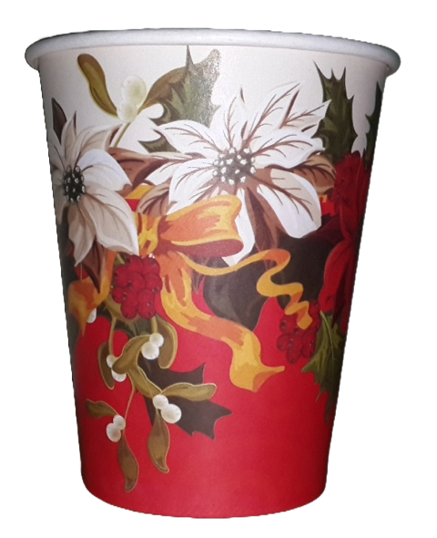
Vandanaa Paper Products
Notes:
Links:
https://www.pexels.com/photo/view-of-high-rise-buildings-during-day-time-302769/

Slide 2
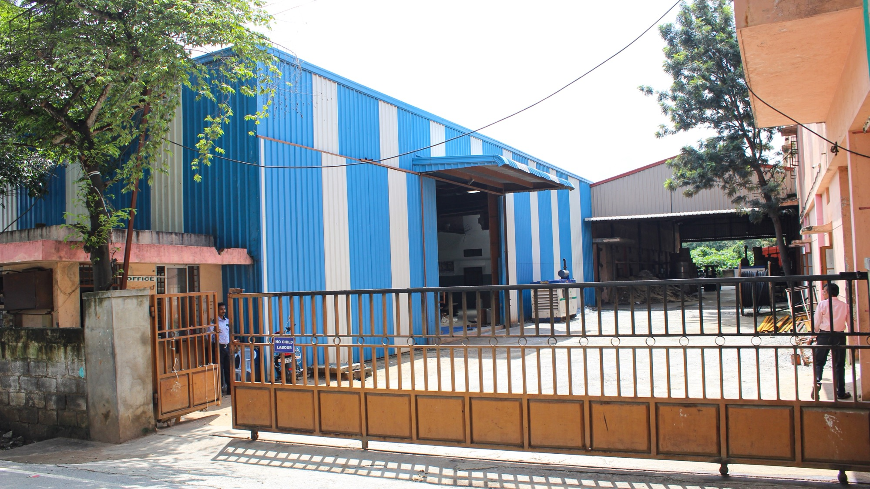

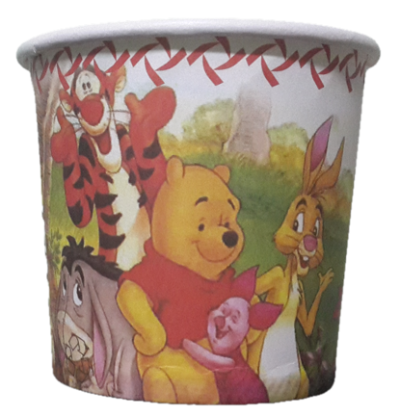
ABOUT US
Vandanaa Paper Products (VPP) has been a trusted name in the manufacturing of premium-quality paper products for food and packaging for over 17 years. Supported by the expertise and leadership of the renowned Lakshmi Group of Industries, we have consistently delivered products that meet the highest standards of excellence. In today’s fast-paced, competitive environment, we recognize that quality is the key to success. With a focus on continuous improvement and innovation, we have established ourselves as a reliable partner for both domestic and international clients. Our commitment to delivering superior paper solutions has enabled us to thrive in this ever-evolving industry, making us a benchmark for quality and performance.
With this strong foundation, Vandanaa Paper Products ensures competitive pricing and delivers exceptional value for money, consistently meeting the expectations of its customers.
Notes:
Links:
https://www.pexels.com/photo/photo-of-people-near-wooden-table-3184418/

Slide 3
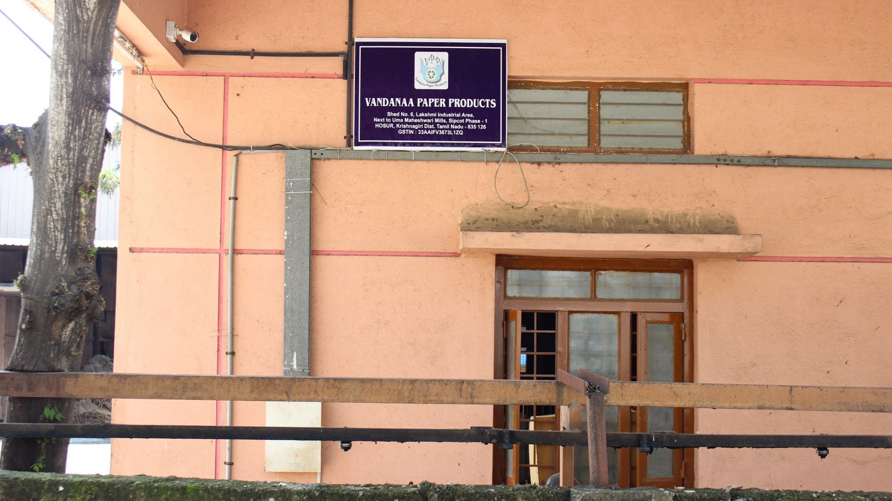
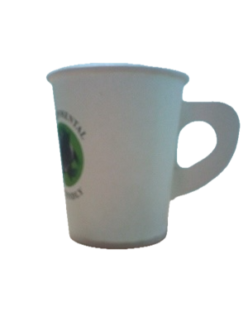
WHO WE ARE
Vandanaa Paper Products was founded through the partnership of two visionary women entrepreneurs, Mrs. Lakshmi Padmanaban and Mrs. P. Vandana. Strategically located in the heart of the Lakshmi Industrial Area, a hub for printing and packaging industries, the company benefits from the rich legacy of successful enterprises in the region over the past three decades.
The company is managed by Mrs. P. Vandana, an Engineering graduate in Computer Science with over 20 years of experience in the paper product industry, following a prior career in software. This diverse background allows Vandanaa Paper Products to operate with a structured approach, blending best practices from both the software and paper industries. The company's growth is further supported by Mr. N. Padmanaban, a respected industrialist in Hosur and a pioneer in paper-based industries, providing invaluable guidance and expertise.
Notes:
Links:
https://www.pexels.com/photo/photo-of-woman-wearing-eyeglasses-3184405/

Slide 4
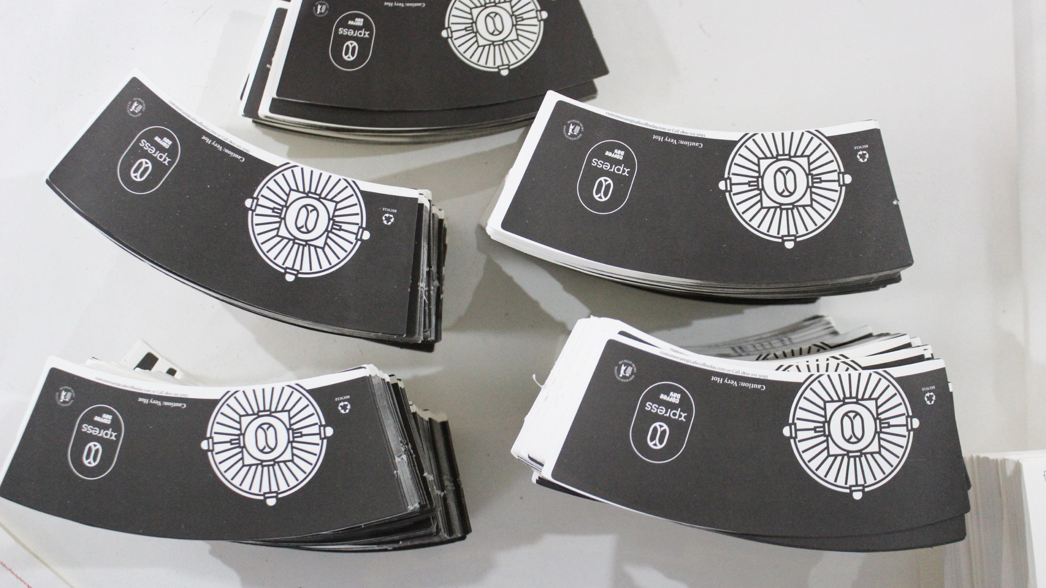
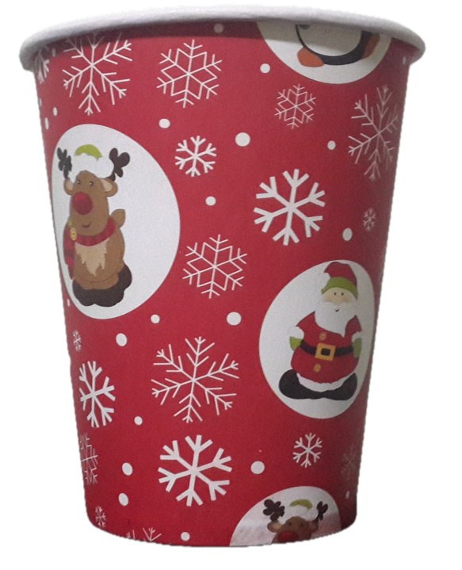
WHAT WE DO
Vandanaa Paper Products currently specializes in the manufacturing of high-quality paper cups, catering to a wide range of industries. Leveraging our close relationships with parent group’s packaging factories, we are equipped to meet the diverse needs of our clients by providing any type of custom packaging cartons. This flexibility allows us to offer a comprehensive range of packaging solutions, ensuring that we can meet the evolving demands of our customers while maintaining the highest standards of quality and reliability. However, our capabilities extend far beyond this product line. With our strong expertise in packaging and printing solutions, we diversify into the production of food boxes, paper bags, packaging materials, and various other packaging products too.
Notes:
Links:
https://www.pexels.com/photo/photo-of-woman-wearing-eyeglasses-3184405/

Slide 5
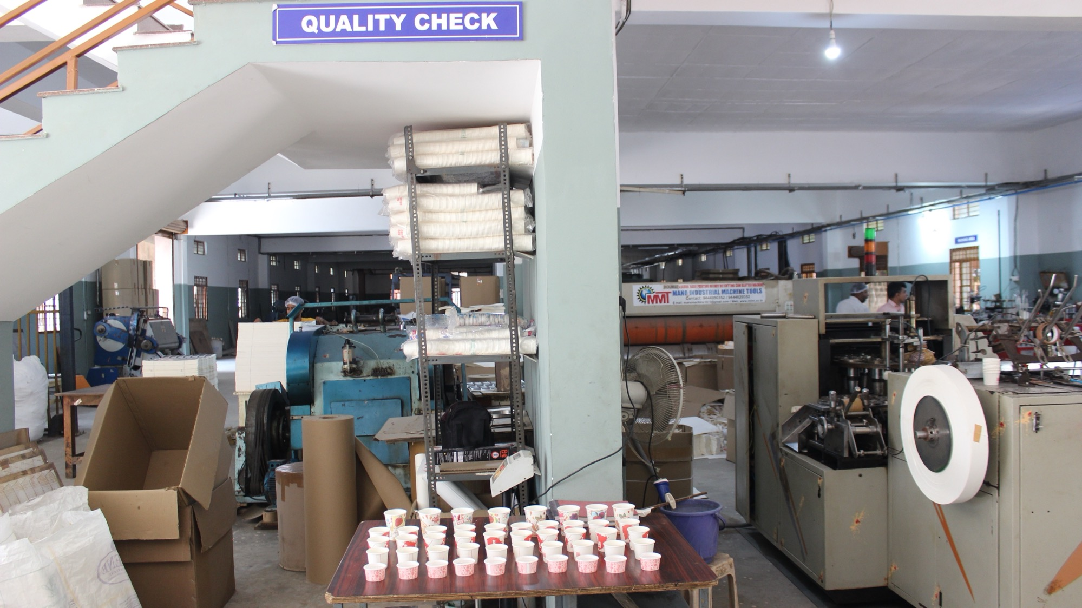




How we do – Our Values
Innovation – Continuously seeking new ways to improve our products and processes.
Commitment – Dedicated to delivering quality and value to our customers.
Accountability – Taking responsibility for our actions and ensuring transparency in all dealings.
Respect – Valuing our partners, customers, employees, and the environment.
Excellence – Striving for the highest standards in everything we do.
Thus achieving
Great Customer Service
Proud Achievements
Industry Excellence
Formidable Competitive Edge
Notes:
Links:
https://www.pexels.com/photo/photo-of-people-holding-each-other-s-hands-3184434/

Slide 6
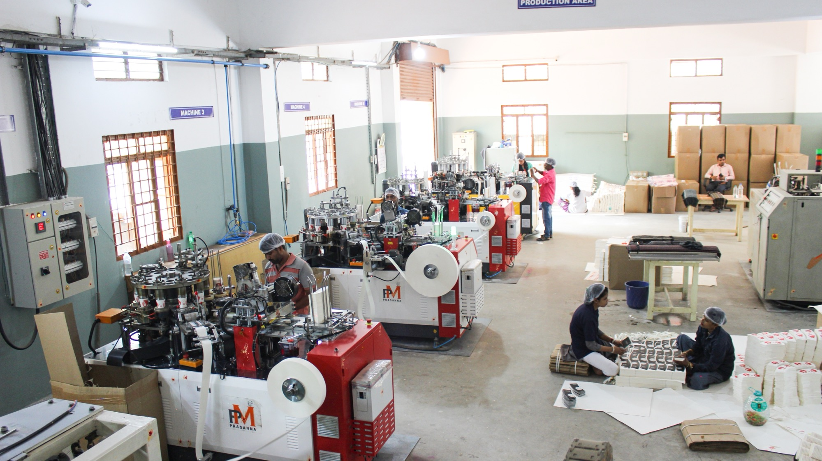
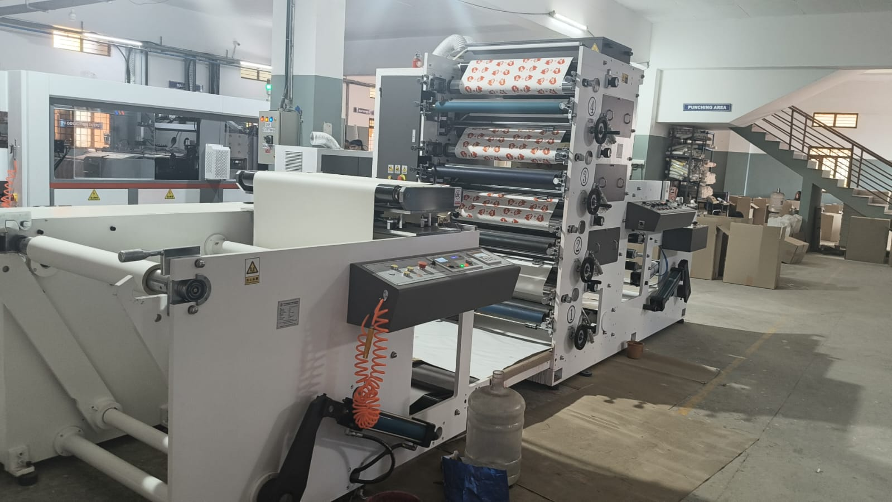
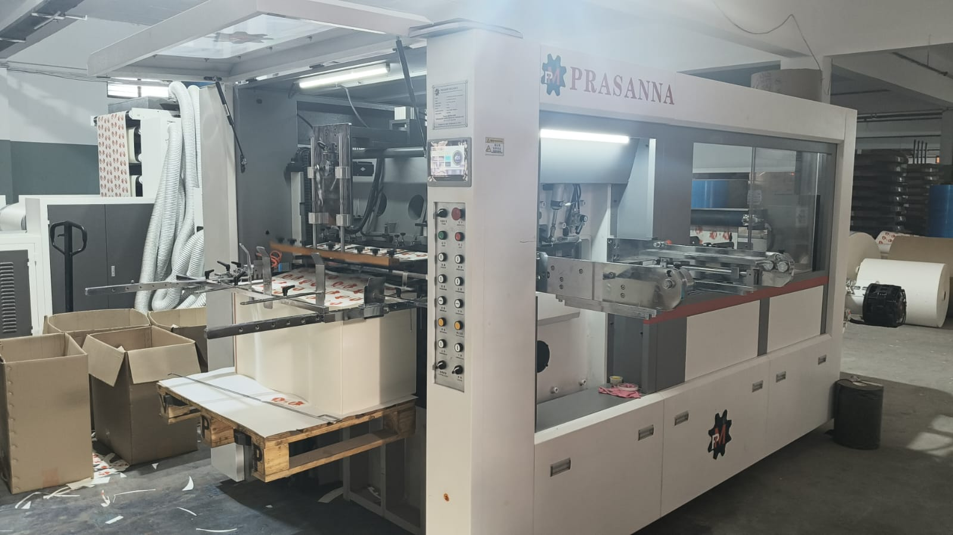
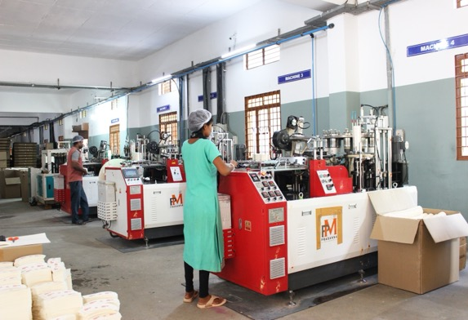
How we do – Manufacturing
Flexo printing machine: Our Flexo printing machine provides exceptional print quality, enhancing the visual appeal of our products and ensuring brand excellence.
Auto die-cutting machine: Our automatic die-cutting machine operates at high speed and with great precision. We maintain control over the entire production process (from reel to cup), ensuring efficiency and consistency in product shaping and design.
High-speed paper cup machines: These state-of-the-art new machines ensure rapid production rates and high-volume output, meeting substantial demand with precision and reliability to tune of 1.2 crore cups per month.
Qualified packing team: With over 40 years of combined experience, our team specializes in the quality check of paper cups, ensuring that each product meets our stringent standards before packing.
Packing cartons procured from our parent group company: This arrangement allows us to tailor carton specifications quickly and ensures a constant and reliable supply, streamlining our packaging process.

Slide 7
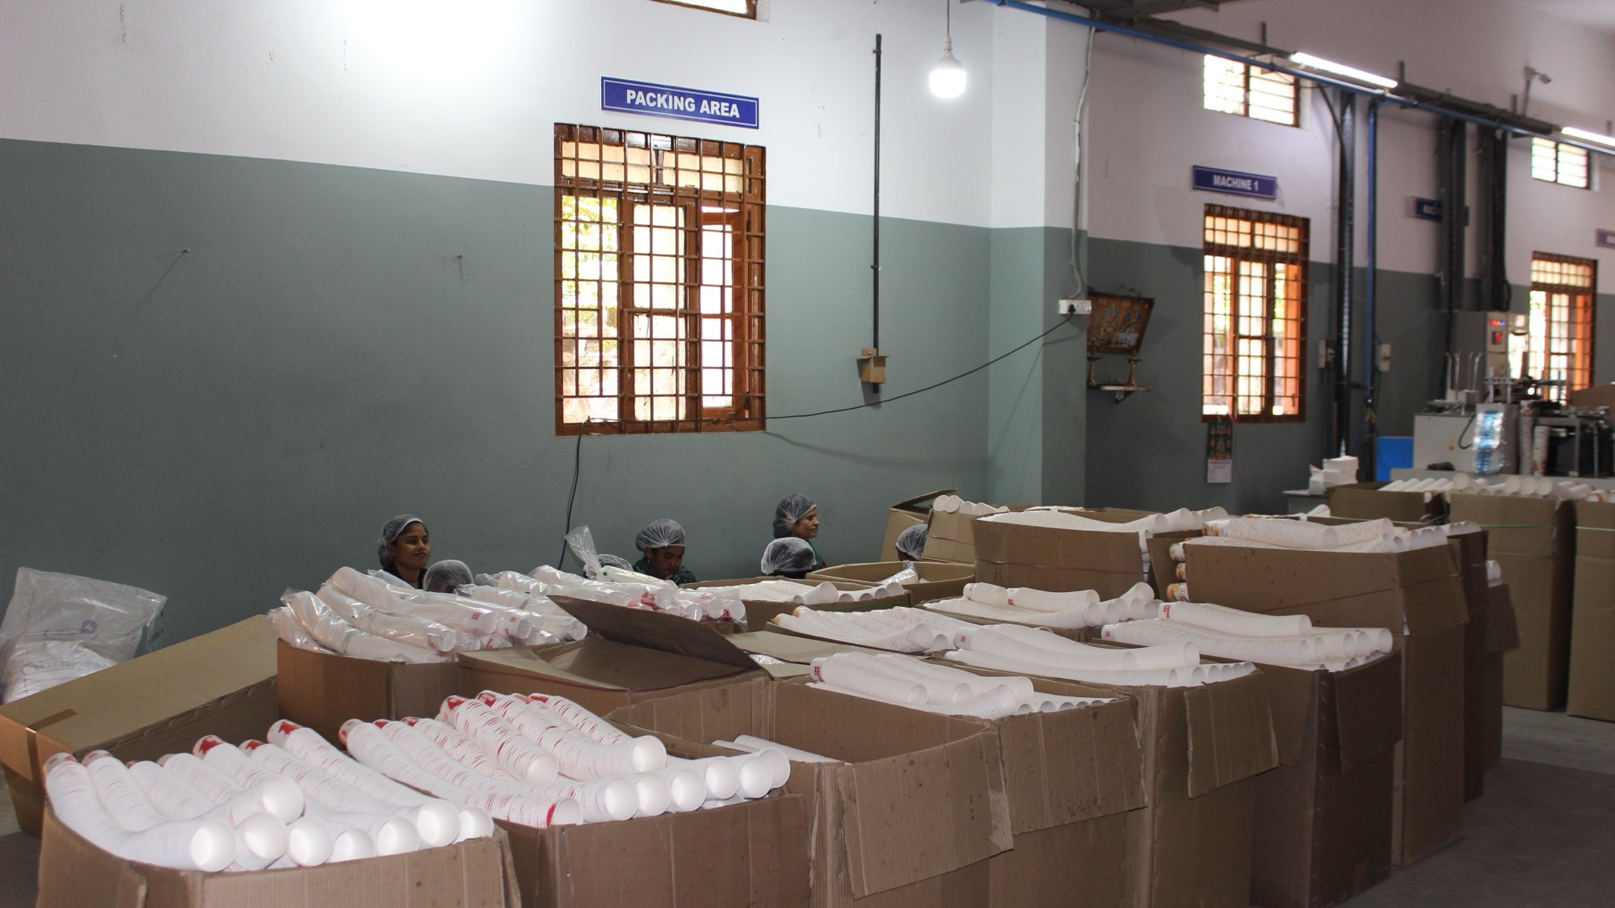
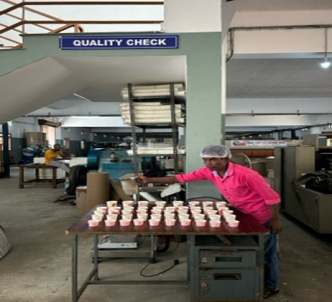
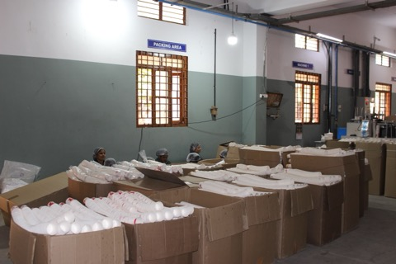
How we do – Quality
At Vandanaa Paper Products, we recognize that thriving in a competitive market extends beyond competitive pricing; it hinges on unparalleled quality. To uphold this commitment, we adhere to rigorous processes and principles:
Daily start-of-day and end-of-day checklists for machinery and stock, with sign-off confirmation.
Hourly destructive testing of end products to ensure consistent quality.
Precision tuning of machinery based on testing results, maintaining optimal performance.
An unwavering focus on hygiene, critical to our food industry clientele.
These practices reflect our dedication to quality and our promise to deliver excellence.
Notes:
Links:
https://www.pexels.com/photo/photo-of-people-holding-each-other-s-hands-3184434/

Slide 8
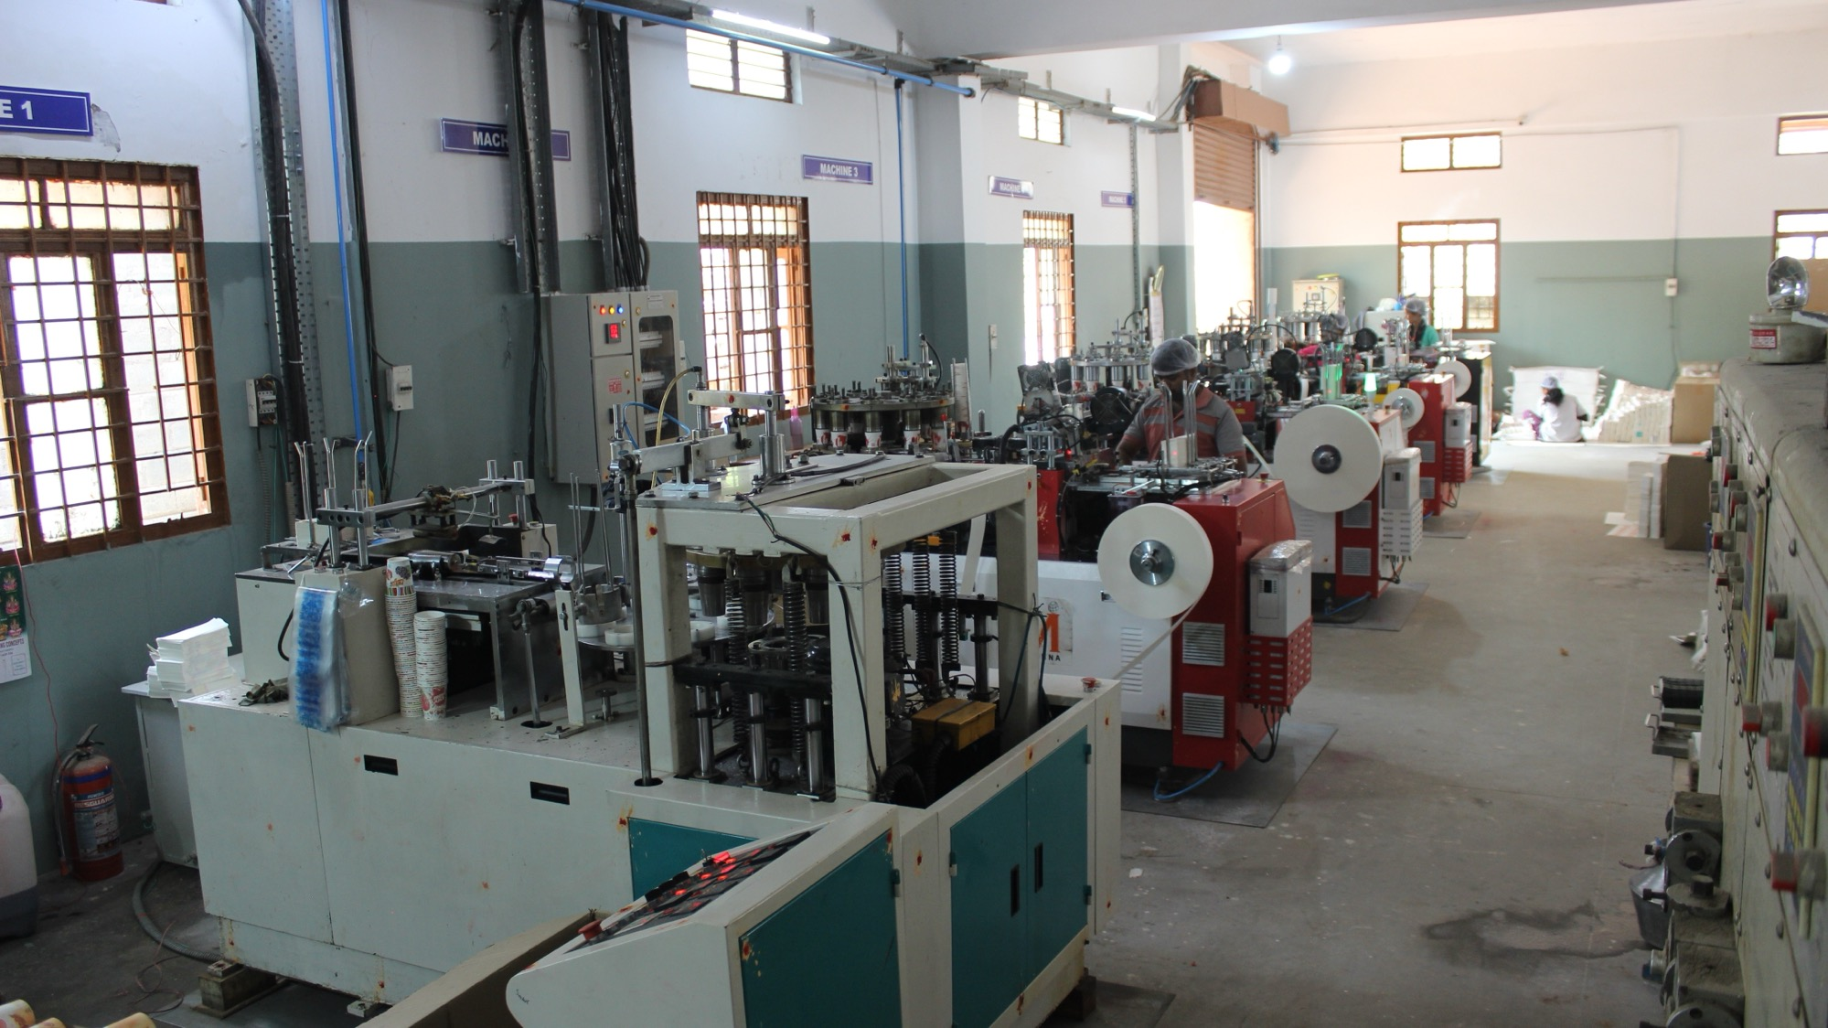
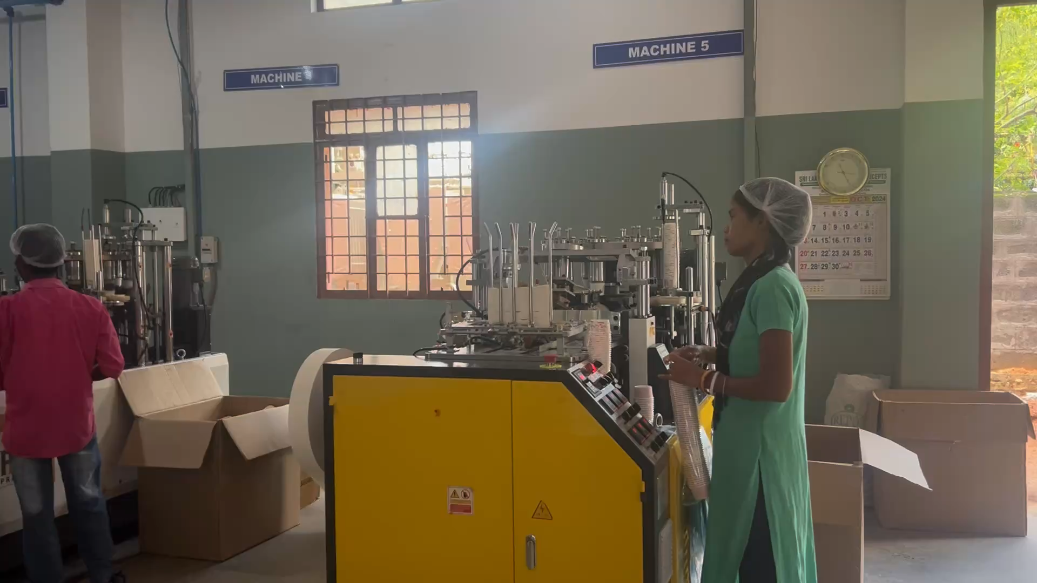
Success is no accident. It is hard work, perseverance, learning, studying, sacrifice and most of all, love of what you are doing or learning to do.
- Pele

Slide 9
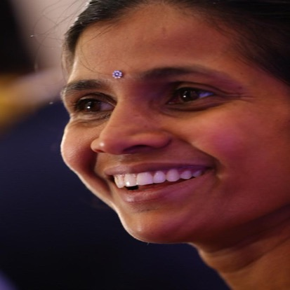
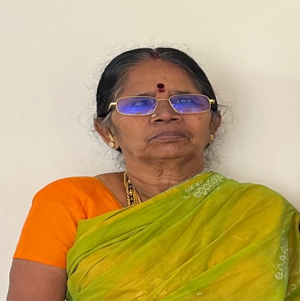
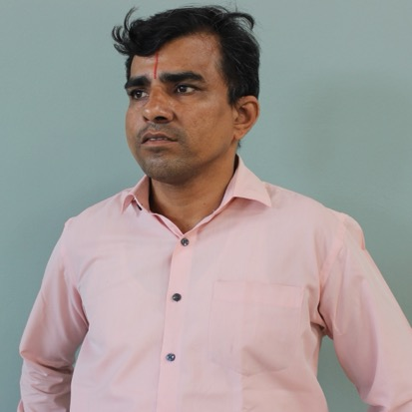
OUR TEAM
Vandana Padmanaban
Lakshmi Padmanaban
S. Srinivasan
Partner
Partner
Factory in-charge
Notes:
Links:
https://www.pexels.com/photo/men-s-wearing-black-suit-jacket-and-pants-937481/
https://www.pexels.com/photo/man-holding-white-teacup-in-front-of-gray-laptop-842567/
https://www.pexels.com/photo/portrait-of-woman-in-office-3747435/

Slide 10
THANK YOU!
Notes:
Links:
https://www.pexels.com/photo/view-of-high-rise-buildings-during-day-time-302769/

